Slide 1
Lecture 21

Slide 2
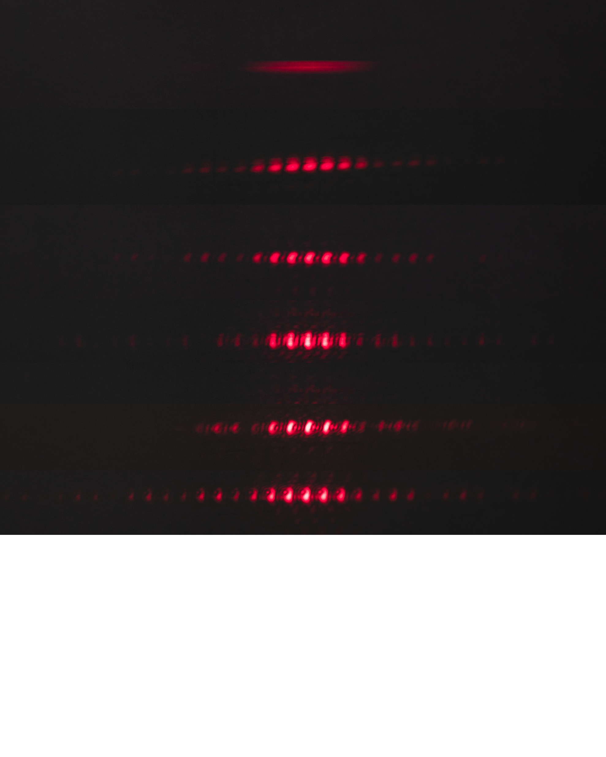
One Slit
Two Slits
Three Slits
Four Slits
Five Slits
Six Slits
Principle Maxima
Secondary Maxima

Slide 3

I
Interference fringes:
due to having a single slit
-2π
-π
π
2π
φ/2

Slide 5
Question 223.11.0.1
1
What is the path difference between ray 1 and ray 2?
a)
b)
c)
d)
2
3
a/2
θ
a

Slide 6
Single-Slit Diffraction
a/2
θ
a

Slide 7
Single-Slit Diffraction
5
4
3
2
1
a/2
a
θ

Slide 8

Single-Slit Diffraction
5
4
3
2
1
a/2
a
θ
$$\frac{a}{4}\sin{θ}$$

Slide 9

Single-Slit Diffraction
Δy
a
θ
$$∆y\sin{θ}$$

Slide 10
ĵ
P
y
h
θ
-x_{max}
x
x_{max}
î

Slide 13


$$E_{o}$$
$$η$$

Slide 14
C
b
a
A
B
c
$$b^{2}=a^{2}+c^{2}−2ac\cos\left(B\right)$$

Slide 15

$$E_{o}$$
η
θ

Slide 16
Single-Slit Diffraction
Δy
a
θ
$$∆y\sin{θ}$$

Slide 17
ΔE_{N}
E_{R}
ΔE₃
ΔE₂
ΔE₄
ΔE₁

Slide 19
O
R
R
E_{R}/2
E_{R}
ζ

Slide 20
ψ
β
η
ζ
β
γ

Slide 21
O
R
R
ψ
β
R
R
E_{R}/2
E_{R}
E_{R}
ζ
η
β
γ
ζ

Slide 25
I
Interference fringes:
due to having a single slit
-2π
-π
π
2π
φ/2

Slide 26
End

